Slide 1
CyberSkills2Work The National Cybersecurity Workforce Development Program

Slide 2
Industrial Control Systems Security
Acknowledgement
This program is funded by the National Security Agency National Centers of Academic Excellence in Cybersecurity (NCAE-C) Program.
For additional information, please visit www.CyberSkills2Work.org.
Course Title
CRN
©2024 CyberSkills2Work - Institution Name

Slide 3

Module 08 - Incident Response
Notes:
Graphic generated by ChatGPT

Slide 4
Module Objectives
Discuss unique challenges in ICS Incident Response
Discuss creating a comprehensive incident response plan
Identify root cause identification tools
Explain containment strategies
Discuss SIEMs and log analysis
Discuss Universal Forwarders
Discuss Malicious Processes and Users

Slide 5
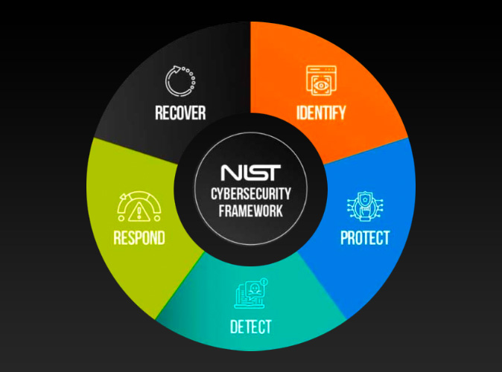
Challenges in Incident Response for ICS
Limited Downtime Tolerance
Highly Specialized and Interconnected Systems
Difficulty in Applying Traditional IT Security Solutions
Complex Communication Protocols
Lack of Incident Visibility
Skilled Personnel Shortage
Notes:
Limited Downtime Tolerance
- ICS systems often run critical processes 24/7.
- Any downtime could lead to:
Production delays.
Financial losses.
Safety hazards.
Highly Specialized and Interconnected Systems
- ICS environments include:
Proprietary hardware and software.
Legacy systems with limited support.
- Interdependencies between OT (Operational Technology) and IT systems.
Difficulty in Applying Traditional IT Security Solutions
- Patching and updates are often delayed due to:
Fear of disrupting operations.
Incompatibility with legacy systems.
- Standard IT tools may not understand ICS-specific protocols.
Complex Communication Protocols
- ICS uses unique protocols (e.g., Modbus, DNP3, OPC) not typically monitored by IT tools.
- Lack of encryption or authentication in some protocols.
Lack of Incident Visibility
- Limited monitoring and logging in ICS environments.
- Difficulty in identifying Indicators of Compromise (IOCs).
Skilled Personnel Shortage
- Incident response teams often lack ICS-specific knowledge.
- Coordination between IT and OT teams is challenging.
Graphic Source: https://www.industrialdefender.com/blog/how-to-apply-nist-cybersecurity-framework-ics

Slide 6
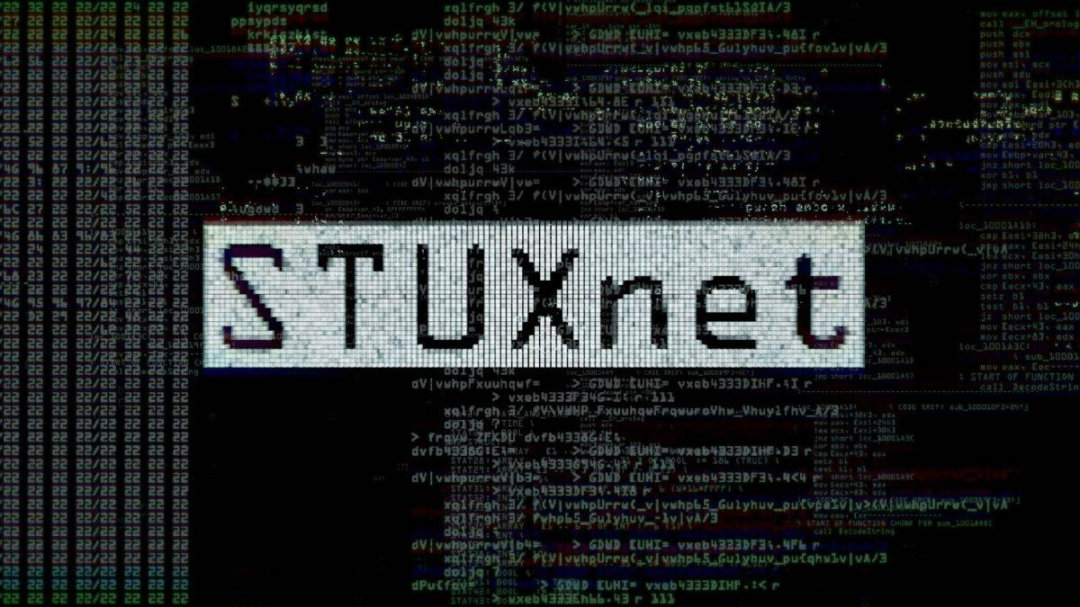
Top Threats to ICS Environments
Ransomware Attacks
Supply Chain Vulnerabilities
Insider Threats
Targeted Malware
Nation-State Attacks
Physical Access Exploitation
Notes:
Ransomware Attacks
Example: Colonial Pipeline (2021) – Shut down fuel supply across the U.S. East Coast.
Threats:
Operational disruptions.
Data encryption and financial extortion.
Supply Chain Vulnerabilities
Example: SolarWinds Attack (2020) – Compromised software updates used to access ICS networks.
Threats:
Malicious code embedded in trusted systems.
Potential for widespread impact.
Insider Threats
Threats:
Sabotage by disgruntled employees or contractors.
Unauthorized access or accidental misconfigurations.
Targeted Malware
Example: Stuxnet (2010) – Targeted Iran's nuclear centrifuges.
Example: Triton (2017) – Targeted safety systems.
Threats:
Disruption of physical processes.
Potential safety risks to personnel and equipment.
Nation-State Attacks
Motivations:
Espionage.
Sabotage of critical infrastructure during geopolitical tensions.
Example: Ukraine Power Grid Attack (2015, 2016) – BlackEnergy malware caused widespread outages.
Physical Access Exploitation
Threats:
Unauthorized personnel tampering with devices.
Poorly secured remote access terminals.
Graphic Source: https://dgap.org/en/research/publications/why-great-powers-launch-destructive-cyber-operations-and-what-do-about-it

Slide 7

Balancing Safety and Security
Safety vs Security
Challenges in Achieving Balance
Examples of Conflicts
Strategies for Balancing
Integrated Safety and Security Plans
Network Segmentation
Regular Risk Assessments
Notes:
Safety vs. Security
- Safety: Protecting personnel, equipment, and processes from harm.
- Security: Preventing unauthorized access and mitigating cyber threats.
- These priorities can sometimes conflict!
Example: An emergency shutdown procedure may bypass certain security protocols.
Challenges in Achieving Balance
- Legacy systems may prioritize safety without considering modern security threats.
- Security measures like patches or reboots can inadvertently disrupt safe operations.
- Miscommunication between safety engineers and cybersecurity teams.
Examples of Conflicts
- Emergency stop systems might be exploited by attackers.
- Safety-critical devices like PLCs are often left unpatched to avoid operational disruptions.
- Physical access controls can delay emergency responses if overly strict.
Strategies for Balancing
- Integrated Safety and Security Plans:
Ensure collaboration between OT and IT teams.
Develop incident response plans that consider both safety and security.
- Network Segmentation:
Isolate safety-critical systems from less secure network zones.
- Regular Risk Assessments:
Evaluate the impact of security measures on safety and vice versa.
Graphic Source: https://images.app.goo.gl/daiVc3d3Pr9H3JDT8

Slide 8
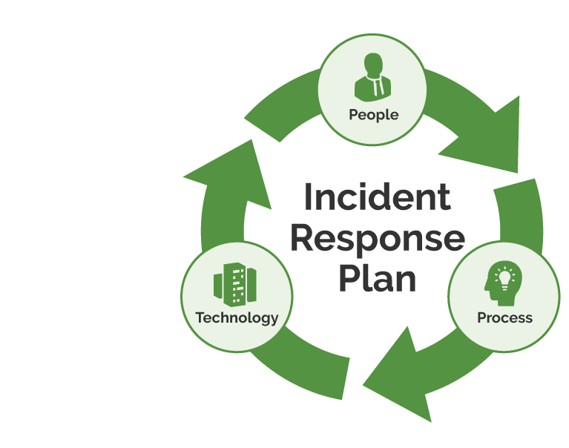
Comprehensive Incident Response Plan
Notes:
Graphic: https://skywardit.com/blog/creating-an-effective-incident-response-plan/

Slide 9
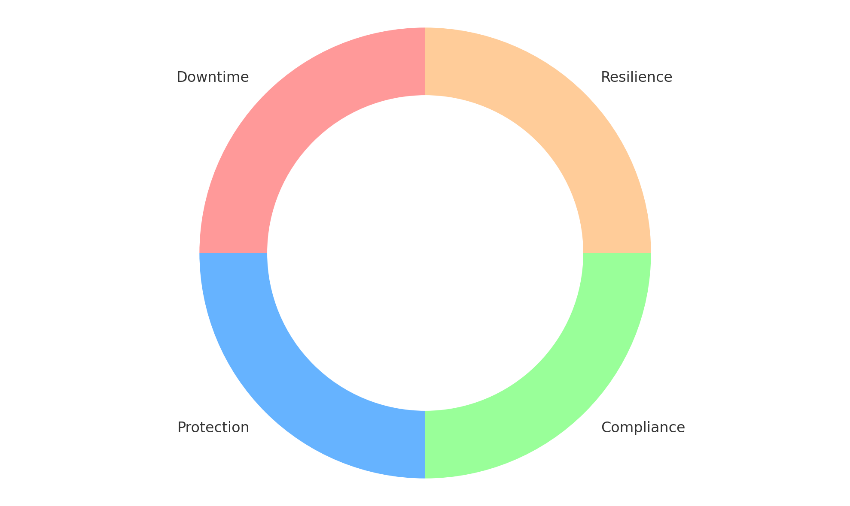
Why is an Incident Response Plan Critical?
Minimizes Downtime and Operational Disruptions
Protects Critical Systems and Processes
Ensures Regulatory Compliance
Strengthens Organizational Resilience
Notes:
Minimizes Downtime and Operational Disruptions
-ICS systems are critical to operations.
-A response plan helps mitigate the impact of attacks and ensures swift recovery.
Example: A coordinated response during a ransomware attack can prevent extended production outages.
Protects Critical Systems and Processes
-Ensures safety and reliability of essential processes.
-Prevents cascading failures in interconnected systems.
Ensures Regulatory Compliance
-Meets standards such as:
NIST SP 800-61 (Incident Response Guide).
IEC 62443 (Security for ICS).
-Avoids fines, penalties, or reputational damage.
Strengthens Organizational Resilience
-Identifies weaknesses through pre-incident planning.
-Builds confidence among stakeholders (e.g., management, customers).
-Supports continuous improvement of security posture.
Graphic Source: ChatGPT: “A circular diagram with the four points (Downtime, Protection, Compliance, Resilience) forming a cycle.”

Slide 10
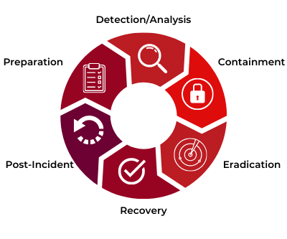
Key Components of an Incident Response Plan
Preparation
Risk assessments and asset inventory
Training and tabletop exercises
Detection and Analysis
Identifying IOCs
Monitoring tools
Containment, Eradication, and Recovery
Post-Incident Activities
Notes:
Preparation
Conduct risk assessments and identify critical ICS assets.
Create an asset inventory, including hardware, software, and processes.
Train personnel through workshops and tabletop exercises.
Establish communication plans with internal and external stakeholders.
Detection and Analysis
Identify potential Indicators of Compromise (IOCs).
Utilize monitoring tools (e.g., SIEMs, IDS) tailored for ICS environments.
Correlate data across systems to confirm incidents.
Prioritize response based on the severity and potential impact.
Containment, Eradication, and Recovery
Containment:
Implement network segmentation to isolate affected systems.
Utilize emergency shutdown procedures if necessary.
Eradication:
Remove malware or unauthorized access points.
Patch vulnerabilities exploited during the incident.
Recovery:
Restore systems to a safe operational state.
Validate systems through testing before resuming full operations.
Post-Incident Activities
- Conduct a Lessons Learned session:
Analyze root causes and identify gaps in the response.
Update the response plan based on findings.
- Document the incident in detail for compliance and training purposes.
Graphic Source: https://images.app.goo.gl/eSSP5FFrWQ9mSCVh8

Slide 11
Roles and Responsibilities
Incident Commander: Oversees the entire response process.
Forensics Lead: Analyzes compromised systems and collects evidence.
Communication Manager: Handles internal and external communications.
IT/OT Specialists: Focus on system-specific recovery tasks.
Legal and Compliance Teams: Ensure actions align with regulations.
Notes:
Incident Commander
Oversees the entire response process.
Coordinates between teams (IT, OT, legal, management).
Makes critical decisions, including escalation and containment strategies.
Forensics Lead
Collects and analyzes evidence from affected systems.
Determines the root cause, scope, and impact of the incident.
Ensures evidence is preserved for potential legal actions.
Communication Manager
Handles communication with internal and external stakeholders.
Coordinates messaging to regulatory agencies, customers, and the public.
Ensures accurate and timely information is shared.
IT/OT Specialists
-IT Team:
Identifies and mitigates threats in the IT environment.
Works with monitoring tools (e.g., SIEMs, IDS) to detect anomalies.
-OT Team:
Focuses on securing ICS-specific assets (PLCs, HMIs, SCADA systems).
Ensures minimal disruption to critical processes.
Legal and Compliance Teams
Ensures all actions align with industry regulations and legal requirements.
Assists in preparing documentation for audits or legal proceedings.
Advises on notifying affected parties and regulatory bodies.
Graphic Source: none

Slide 12

Incident Response Procedures
Playbooks for common ICS incidents
Ransomware
Unauthorized access
Checklists for containment and eradication steps
Decision trees for escalation paths
Example: Response to Ransomware in ICS
Detection
Containment
Eradication
Recovery
Notes:
Importance of Well-Defined Procedures
Provides a clear roadmap for handling incidents.
Reduces response time and ensures consistency.
Aligns actions with safety and regulatory requirements.
Playbooks for Common ICS Incidents
Example Scenarios:
Ransomware in SCADA systems.
Unauthorized access to PLCs.
Malware detected on an HMI.
Components of a Playbook:
Detection steps.
Containment strategies.
Eradication and recovery actions.
Incident Response Checklists
Ensure key tasks are completed during high-pressure situations.
Examples of checklist items:
Confirm incident severity.
Notify appropriate personnel and stakeholders.
Isolate affected systems.
Decision Trees for Escalation
Help responders decide:
When to escalate incidents to management or external teams.
Whether to involve law enforcement or regulatory bodies.
Steps to follow based on incident type (e.g., ransomware vs. insider threat).
Example: Response to Ransomware in ICS
Detection: Identify encrypted files or ransom notes.
Containment: Isolate affected systems and block external access.
Eradication: Remove malware and validate system integrity.
Recovery: Restore from backups and ensure operational safety.
Graphic Source: https://images.app.goo.gl/LgymEayBwfFXQV8Q7

Slide 13
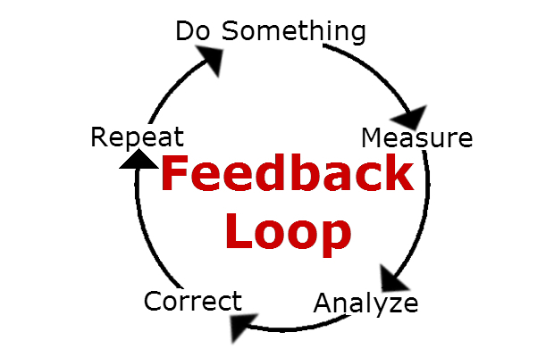
Testing and Improving the Plan
Tabletop Exercises: Simulated scenarios to test readiness.
Red Team/Blue Team Drills: Assess defense and response capabilities.
Feedback Loops: Continuously refine based on test outcomes.
Notes:
Why Testing is Essential
Validates the effectiveness of the plan.
Identifies gaps or weaknesses in procedures.
Builds confidence in the response team’s readiness.
Types of Tests
Tabletop Exercises:
Simulated scenarios to discuss responses in a low-stress environment.
Example: Discussing steps to handle a ransomware attack on a SCADA system.
Red Team/Blue Team Drills:
Red Team simulates an attack while the Blue Team defends.
Improves detection and response capabilities.
Full-Scale Simulations:
Realistic incident response drills involving live environments.
Tests end-to-end readiness, including technical and communication protocols.
Feedback Loops
Conduct post-exercise reviews:
What went well?
What needs improvement?
Update procedures, runbooks, and training based on findings.
Use metrics to measure improvements (e.g., response time, containment efficiency).
Continuous Improvement
Regularly update the plan to address:
New threats and vulnerabilities.
Changes in ICS technology or configurations.
Lessons learned from real-world incidents.
Collaborate with IT, OT, and external experts to stay ahead of threats.
Graphic Source: https://images.app.goo.gl/bc2Yqp4c5TUVVW649

Slide 14

Root Cause Identification Tools
Notes:
Graphic: https://images.app.goo.gl/BJghzcPXMeSaGkLQ8

Slide 15
Key Categories of Tools
Log Analysis Tools
Splunk, Elastic Stack (ELK), Graylog
Analyze logs from ICS devices (PLCs, SCADA, HMIs)
Network Monitoring Tools
Wireshark, Zeek, tcpdump
Monitor traffic and identify anomalies in ICS-specific protocols
System Monitoring Tools
Sysinternals Suite, OSQuery
Detect changes in processes, registry keys, and file systems
Notes:
Log Analysis Tools
Purpose:
Centralize and analyze logs from ICS devices and supporting systems.
Detect anomalies or changes indicating malicious activity.
Examples:
Splunk: Powerful querying and visualization for large-scale log data.
Elastic Stack (ELK): Open-source stack for real-time log search and analysis.
Graylog: Log management with tailored dashboards.
Use Cases:
Tracking configuration changes in PLCs.
Detecting unauthorized system logins.
Network Monitoring Tools
Purpose:
Monitor and analyze traffic for anomalies, suspicious activity, or unauthorized access.
Examples:
Wireshark: In-depth packet analysis, including ICS-specific protocols like Modbus.
Zeek (formerly Bro): Network traffic metadata analysis.
tcpdump: Lightweight tool for capturing and analyzing network packets.
Use Cases:
Identifying abnormal traffic to or from field devices.
Detecting unauthorized remote connections.
System Monitoring Tools
Purpose:
Monitor system states, detect unauthorized changes, and track active processes.
Examples:
Sysinternals Suite: Tools like Process Explorer and Autoruns for forensic analysis.
OSQuery: Framework for querying system configurations and states.
Use Cases:
Detecting fileless malware or unusual processes on HMIs or engineering workstations.
Analyzing startup persistence mechanisms in ICS endpoints.
Graphic Source: none

Slide 16

Using Log Analysis Tools
Key Sources of Logs
ICS-Specific logs
Network logs
Endpoint logs
Steps in Log Analysis
Step 1: Centralize logs
Step 2: Define queries to search
Step 3: Correlate logs
Step 4: Visualize findings
Notes:
Purpose of Log Analysis
Logs provide critical visibility into ICS operations and security events.
Enable detection of anomalies and correlation of activities across systems.
Offer evidence for root cause analysis and incident reconstruction.
Key Sources of Logs in ICS Environments
ICS-Specific Logs:
PLCs, SCADA systems, and RTUs.
Example: Changes in PLC configurations.
Network Logs:
Firewall and router logs showing traffic patterns.
Example: Unauthorized external connections.
Endpoint Logs:
Windows Event Logs and application logs from HMIs or engineering workstations.
Example: Failed login attempts or system crashes.
Common Log Analysis Tools
Splunk:
Advanced querying and dashboard creation.
Visualize trends and anomalies in real time.
Elastic Stack (ELK):
Open-source and highly customizable for searching and visualizing log data.
Graylog:
User-friendly log management with built-in alerting.
Tool Example: Search for failed logins across multiple HMIs.
Steps in Log Analysis
Step 1: Centralize logs using a SIEM or log aggregation tool.
Step 2: Define queries to search for Indicators of Compromise (IOCs).
Step 3: Correlate logs from different systems to identify patterns.
Step 4: Visualize findings for stakeholders and decision-makers.
Real-World Use Case
Scenario: Detecting Unauthorized PLC Access.
Log analysis identifies repeated login failures on a specific PLC.
Correlated with unusual IP traffic from an external source.
Result: Early detection of an attempted breach.
Graphic Source: https://images.app.goo.gl/rGhn36q1sHbL6hmf6

Slide 17

Network Monitoring Tools in Action
Key Network Monitoring Tools
Wireshark
Zeek (formerly Bro)
Tcpdump
ICS-Specific Protocol Monitoring
Steps in Network Monitoring
Step 1: Establish baselines
Step 2: Continuously monitor for deviations
Step 3: Analyze packet captures
Step 4: Correlate findings
Notes:
Purpose of Network Monitoring
Provides visibility into traffic flows within and outside the ICS environment.
Identifies unusual traffic patterns, unauthorized connections, or protocol misuse.
Critical for detecting lateral movement and exfiltration attempts.
Key Network Monitoring Tools
Wireshark:
Packet-level analysis.
Supports ICS protocols like Modbus, DNP3, and OPC-UA.
Example: Analyzing packets for abnormal command activity.
Zeek (formerly Bro):
Network metadata analysis.
Detects anomalies in traffic patterns.
Example: Identifying connections to suspicious Command and Control (C2) servers.
tcpdump:
Lightweight tool for capturing and inspecting packets.
Example: Capturing real-time traffic to monitor a specific ICS device.
ICS-Specific Protocol Monitoring
Common ICS Protocols:
Modbus, DNP3, IEC 60870-5-104, OPC-UA.
Unique challenges:
Many protocols lack encryption or authentication.
Potential for attackers to inject malicious commands.
Steps in Network Monitoring
Step 1: Establish baselines for normal traffic patterns.
Step 2: Continuously monitor for deviations (e.g., unexpected connections).
Step 3: Analyze packet captures to identify malicious activities.
Step 4: Correlate findings with logs and system data for root cause analysis.
Real-World Use Case
Scenario: Detecting Unauthorized Device on the Network.
Zeek identifies an unknown IP address communicating with multiple PLCs.
Wireshark captures reveal the device issuing unauthorized Modbus commands.
Result: Network isolation prevents potential malicious actions.
Graphic Source: https://images.app.goo.gl/8F5dGvQjixDH8Efd7

Slide 18

Monitoring System Changes for Root Cause Analysis
Why Monitor System Changes?
Key Tools for System Monitoring
Sysinternals Suite (Windows-focused)
OSQuery
Endpoint Detection and Response (EDR) Tools
Focus Areas for ICS Monitoring
File System Changes
Registry Modifications
Active Processes and Services
Notes:
Why Monitor System Changes?
Detect unauthorized or suspicious activities on endpoints.
Identify changes to critical configurations or processes.
Provide forensic evidence to trace the root cause of an incident.
Key Tools for System Monitoring
Sysinternals Suite (Windows-focused):
Process Explorer: Identifies malicious or abnormal processes.
Autoruns: Detects startup persistence mechanisms like malware.
Process Monitor: Tracks real-time file, registry, and process activities.
OSQuery:
Open-source tool for querying system state across multiple devices.
Example: Checking for unauthorized registry changes or file modifications.
Endpoint Detection and Response (EDR) Tools:
Example: CrowdStrike or Carbon Black for real-time endpoint monitoring.
Focus Areas for ICS Monitoring
File System Changes:
Unexpected creation or modification of key system files.
Example: Presence of scripts or binaries that are not standard in ICS environments.
Registry Modifications:
Detection of unusual or unauthorized changes in Windows Registry.
Example: Persistence techniques used by malware.
Active Processes and Services:
Identify new or abnormal processes.
Example: Fileless malware running only in memory.
Graphic Source: https://images.app.goo.gl/HUhWaZE17A63ZuZq5

Slide 19
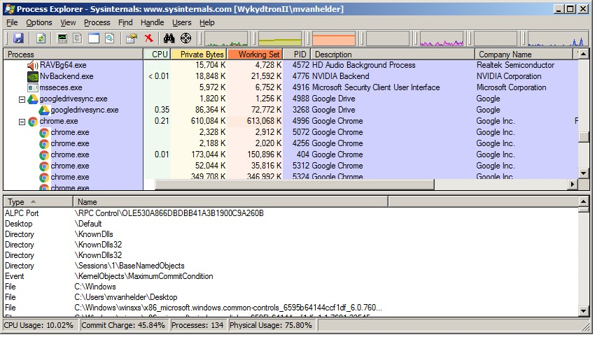
Process Explorer
Notes:
Why Monitor System Changes?
Detect unauthorized or suspicious activities on endpoints.
Identify changes to critical configurations or processes.
Provide forensic evidence to trace the root cause of an incident.
Key Tools for System Monitoring
Sysinternals Suite (Windows-focused):
Process Explorer: Identifies malicious or abnormal processes.
Autoruns: Detects startup persistence mechanisms like malware.
Process Monitor: Tracks real-time file, registry, and process activities.
OSQuery:
Open-source tool for querying system state across multiple devices.
Example: Checking for unauthorized registry changes or file modifications.
Endpoint Detection and Response (EDR) Tools:
Example: CrowdStrike or Carbon Black for real-time endpoint monitoring.
Focus Areas for ICS Monitoring
File System Changes:
Unexpected creation or modification of key system files.
Example: Presence of scripts or binaries that are not standard in ICS environments.
Registry Modifications:
Detection of unusual or unauthorized changes in Windows Registry.
Example: Persistence techniques used by malware.
Active Processes and Services:
Identify new or abnormal processes.
Example: Fileless malware running only in memory.
Graphic Source: https://images.app.goo.gl/pYbfXoccm8W8HjL68

Slide 20
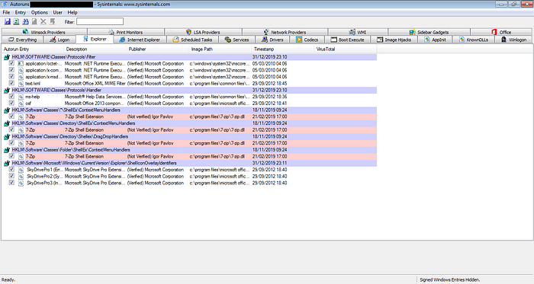
Autoruns
Notes:
Why Monitor System Changes?
Detect unauthorized or suspicious activities on endpoints.
Identify changes to critical configurations or processes.
Provide forensic evidence to trace the root cause of an incident.
Key Tools for System Monitoring
Sysinternals Suite (Windows-focused):
Process Explorer: Identifies malicious or abnormal processes.
Autoruns: Detects startup persistence mechanisms like malware.
Process Monitor: Tracks real-time file, registry, and process activities.
OSQuery:
Open-source tool for querying system state across multiple devices.
Example: Checking for unauthorized registry changes or file modifications.
Endpoint Detection and Response (EDR) Tools:
Example: CrowdStrike or Carbon Black for real-time endpoint monitoring.
Focus Areas for ICS Monitoring
File System Changes:
Unexpected creation or modification of key system files.
Example: Presence of scripts or binaries that are not standard in ICS environments.
Registry Modifications:
Detection of unusual or unauthorized changes in Windows Registry.
Example: Persistence techniques used by malware.
Active Processes and Services:
Identify new or abnormal processes.
Example: Fileless malware running only in memory.
Graphic Source: https://nasbench.medium.com/hunting-malware-with-windows-sysinternals-autoruns-19cbfe4103c2

Slide 21
Monitoring System Changes for Root Cause Analysis (cont’d)
Steps in Monitoring System Changes
Step 1: Establish baselines for system configurations and activities.
Step 2: Set up alerts for deviations from the baseline.
Step 3: Investigate flagged changes to confirm malicious intent.
Step 4: Document findings for incident reports and root cause analysis.
Example: Identifying Fileless Malware on an HMI
Notes:
Steps in Monitoring System Changes
Step 1: Establish baselines for system configurations and activities.
Step 2: Set up alerts for deviations from the baseline.
Step 3: Investigate flagged changes to confirm malicious intent.
Step 4: Document findings for incident reports and root cause analysis.
Real-World Use Case
Scenario: Identifying Fileless Malware on an HMI.
Process Explorer detects a suspicious PowerShell process running in memory.
Further investigation with Process Monitor reveals unauthorized script execution.
Result: Malware is isolated and removed, preventing further impact.
Graphic Source:

Slide 22
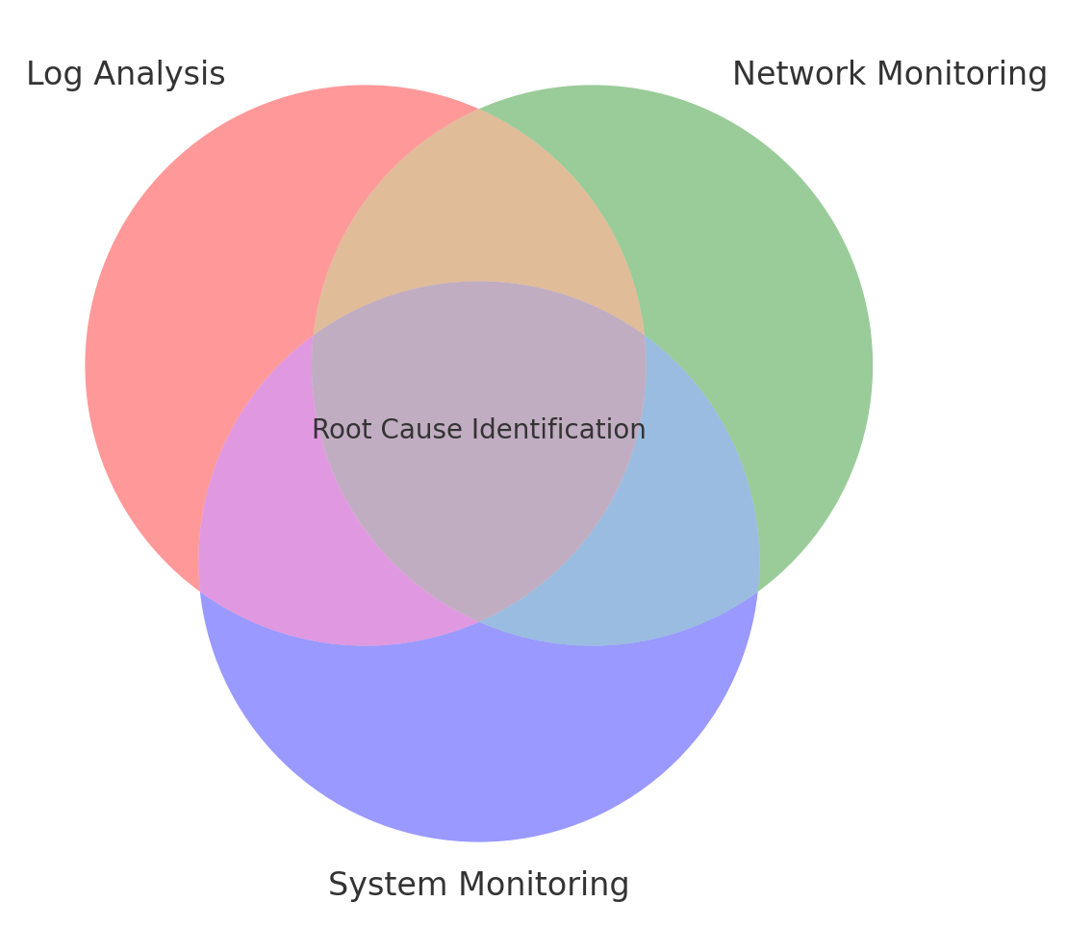
Integrating Tools for Comprehensive Analysis
Why Integration is Critical?
Tools to Integrate
Log Analysis Tools
Network Monitoring Tools
System Monitoring Tools
Integration Workflow
Step 1: Collect data from all sources
Step 2: Correlate findings
Step 3: Use visualization tools
Step 4: Validate findings
Notes:
Why Integration is Critical
No single tool provides a complete picture of an incident.
Combining data from multiple tools allows for a deeper understanding of:
Scope and impact.
Attack vectors.
Root causes.
Tools to Integrate
Log Analysis Tools:
Splunk, ELK Stack, Graylog.
Centralize and correlate log data from ICS devices, endpoints, and networks.
Network Monitoring Tools:
Wireshark, Zeek, tcpdump.
Provide traffic analysis to detect anomalies and lateral movement.
System Monitoring Tools:
Sysinternals Suite, OSQuery.
Focus on processes, registry changes, and file system integrity.
Integration Workflow
Step 1: Collect data from all sources:
Logs, network packets, and system states.
Step 2: Correlate findings:
Example: Match an unauthorized login in logs with suspicious network activity.
Step 3: Use visualization tools:
Dashboards or visual reports to identify patterns and attack paths.
Step 4: Validate findings:
Cross-check with baselines and ICS configurations.
Real-World Example
Scenario: Coordinated Attack on ICS Systems.
Logs: Splunk identifies repeated failed login attempts.
Network Monitoring: Zeek detects unusual outbound traffic to a known malicious IP.
System Monitoring: Sysinternals flags a PowerShell process creating new files.
Result: Tools together uncover a phishing attack leading to lateral movement and malware installation.
Benefits of Integration
Holistic view of incidents.
Faster identification and containment.
Improved collaboration between IT and OT teams.
Graphic Source: ChatGPT
“venn diagram that Displays the overlap between log analysis, network monitoring, and system monitoring with "Root Cause Identification" at the center.”

Slide 23

Containment Strategies in ICS Environments
Notes:
Graphic: https://images.app.goo.gl/PpkUKdQ32ZKGEekTA

Slide 24
Why is Containment Critical?
Minimizes Threat Spread
Reduces Potential Damage
Maintains Safety
Supports Effective Incident Response
Case Study: Ransomware in ICS
Initial infection detected on an HMI.
Containment action: Disconnect the HMI and block its network segment.
Result: Prevented the ransomware from reaching PLCs or SCADA systems.
Notes:
Minimizes Threat Spread
Prevents malware, ransomware, or unauthorized access from moving laterally through the ICS network.
Limits the attack's scope to the initially affected systems.
Reduces Potential Damage
Protects critical systems and processes from being compromised.
Ensures continuity of operations where possible.
Maintains Safety
Safety of personnel and equipment remains a top priority.
Containment measures are designed to avoid triggering unsafe conditions in ICS environments.
Supports Effective Incident Response
Provides time to analyze and plan remediation efforts.
Allows incident response teams to focus on root cause identification without escalation of the issue.
Example Scenario
Case Study: Ransomware in ICS:
Initial infection detected on an HMI.
Containment action: Disconnect the HMI and block its network segment.
Result: Prevented the ransomware from reaching PLCs or SCADA systems.
Graphic Source:

Slide 25
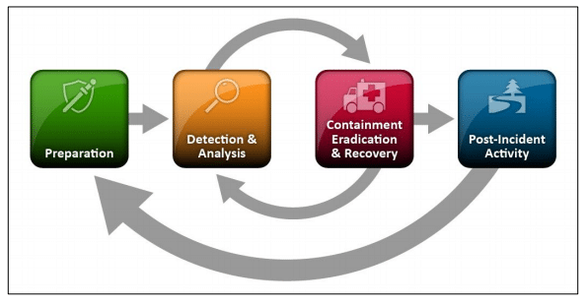
Key Containment Approaches
Network Segmentation
Device Isolation
Access Control Adjustments
Traffic Filtering
Fail-Safe Procedures
Notes:
Network Segmentation
Use VLANs, firewalls, or zone-based architectures to isolate affected systems.
Prevent lateral movement within the ICS environment.
Example:
Segment compromised engineering workstations to block communication with PLCs.
Device Isolation
Disconnect affected devices from the network.
Limit access to critical systems (e.g., SCADA servers, HMIs).
Example:
Physically disconnect an infected HMI to contain ransomware.
Access Control Adjustments
Revoke or disable compromised user accounts.
Apply least privilege access to prevent unauthorized escalation.
Example:
Disable accounts showing signs of unauthorized access or excessive failed login attempts.
Traffic Filtering
Use firewalls or intrusion prevention systems (IPS) to block malicious IPs or ports.
Restrict protocols prone to misuse (e.g., disable Modbus commands from external sources).
Example:
Block external IPs communicating with ICS assets using Zeek alerts.
Fail-Safe Procedures
Implement controlled shutdowns or switch to manual operations when digital containment isn’t sufficient.
Example:
Use emergency stops to isolate physical processes safely in critical conditions.
Graphic Source:https://images.app.goo.gl/GWpDUGAaLf59uSGn6

Slide 26
Tools to Support Containment
Firewalls
Network Access Control (NAC)
Endpoint Detection and Response (EDR)
CrowdStrike
Carbon Black
ICS-Specific Security Tools
Dragos
Nozomi Networks
Intrusion Detection/Prevention Systems (IDS/IPS)
Notes:
Firewalls
Control and block unauthorized connections to and from ICS systems.
Examples:
Palo Alto Networks: Advanced filtering for industrial protocols.
Cisco ASA: Zoning and traffic segmentation.
Use Case:
Block malicious IPs or isolate network zones during an attack.
Network Access Control (NAC)
Dynamically control device access based on security policies.
Example: Cisco Identity Services Engine (ISE).
Use Case:
Automatically quarantine an unauthorized device attempting to join the network.
Endpoint Detection and Response (EDR)
Monitor and isolate endpoints showing malicious behavior.
Examples:
CrowdStrike: Real-time endpoint monitoring and quarantine.
Carbon Black: Detects and stops fileless malware.
Use Case:
Quarantine an infected engineering workstation to prevent further spread.
ICS-Specific Security Tools
Tailored for industrial environments to monitor and contain OT threats.
Examples:
Dragos: Threat detection, response, and asset monitoring.
Nozomi Networks: Real-time ICS network visibility and anomaly detection.
Use Case:
Identify and isolate anomalous Modbus traffic between PLCs.
Intrusion Detection/Prevention Systems (IDS/IPS)
Monitor traffic and block malicious activity in real-time.
Examples:
Suricata: Open-source IDS/IPS for network traffic analysis.
Snort: Detects and blocks known exploits.
Use Case:
Prevent unauthorized access to SCADA servers by blocking specific protocols.
Graphic Source:

Slide 27
Containment in Action: Ransomware Attack
Incident: A ransomware infection spreads on engineering workstations.
Containment Actions:
Disconnect infected workstations from the network.
Use VLANs to isolate the segment containing the infected systems.
Block outbound connections to prevent data exfiltration.
Outcome: Ransomware is contained before it reaches critical PLCs and SCADA systems.
Notes:
Scenario 1: Ransomware Attack
Incident:
A ransomware infection spreads on engineering workstations.
Containment Actions:
Disconnect infected workstations from the network.
Use VLANs to isolate the segment containing the infected systems.
Block outbound connections to prevent data exfiltration.
Outcome:
Ransomware is contained before it reaches critical PLCs and SCADA systems.
Graphic Source:

Slide 28
Containment in Action: Unauthorized Remote Access
Incident: An external IP address accesses a PLC without authorization.
Containment Actions:
Use firewall rules to block the IP address.
Disable the compromised user account.
Conduct additional monitoring to ensure no further access.
Outcome: Remote access is cut off, and further unauthorized activities are prevented.
Notes:
Scenario 2: Unauthorized Remote Access
Incident:
An external IP address accesses a PLC without authorization.
Containment Actions:
Use firewall rules to block the IP address.
Disable the compromised user account.
Conduct additional monitoring to ensure no further access.
Outcome:
Remote access is cut off, and further unauthorized activities are prevented.
Graphic Source:

Slide 29
Containment in Action: Malware on an HMI
Incident: Malware is detected running on a human-machine interface (HMI).
Containment Actions:
Disconnect the HMI from the network.
Revert to manual operations for the connected processes.
Conduct a forensic investigation to identify malware origin.
Outcome: Manual control ensures operational continuity while the HMI is restored.
Notes:
Scenario 3: Malware on an HMI
Incident:
Malware is detected running on a human-machine interface (HMI).
Containment Actions:
Disconnect the HMI from the network.
Revert to manual operations for the connected processes.
Conduct a forensic investigation to identify malware origin.
Outcome:
Manual control ensures operational continuity while the HMI is restored.
Graphic Source:

Slide 30
Challenges in Containment
Operational Continuity vs. Security
Challenge: Containment actions (e.g., isolating devices or shutting down processes) can disrupt critical operations.
Real-Time Decision Making
Challenge: Responders must act quickly with incomplete information.
Coordination Between IT and OT Teams
Challenge: Miscommunication between IT (focused on security) and OT (focused on operations) can delay response efforts.
Notes:
Operational Continuity vs. Security
Challenge: Containment actions (e.g., isolating devices or shutting down processes) can disrupt critical operations.
Example: Disconnecting an infected PLC could halt production, impacting revenue and supply chains.
Solution: Use network segmentation and controlled shutdowns to limit disruption.
Real-Time Decision Making
Challenge: Responders must act quickly with incomplete information.
Example: Delaying containment can allow malware to spread, but acting too soon could isolate unaffected systems.
Solution: Implement predefined containment playbooks for common scenarios.
Coordination Between IT and OT Teams
Challenge: Miscommunication between IT (focused on security) and OT (focused on operations) can delay response efforts.
Example: IT isolates a system without informing OT, leading to process disruptions.
Solution: Foster collaboration through joint training and shared incident response plans.
Graphic Source:

Slide 31

Challenges in Containment (cont’d)
Identifying Scope of the Incident
Challenge: Determining which systems are affected and where to focus containment efforts.
Balancing Safety with Containment
Challenge: Some containment actions might unintentionally compromise safety.
Notes:
Identifying Scope of the Incident
Challenge: Determining which systems are affected and where to focus containment efforts.
Example: A single compromised workstation vs. a network-wide ransomware attack.
Solution: Leverage monitoring tools to quickly map the scope of the incident.
Balancing Safety with Containment
Challenge: Some containment actions might unintentionally compromise safety.
Example: Isolating an ICS device could disable safety controls, such as emergency shutdowns.
Solution: Ensure safety-critical systems remain operational during containment.
Graphic Source: ChatGPT
“Illustrate a decision-making process balancing security, safety, and operational needs.”

Slide 32
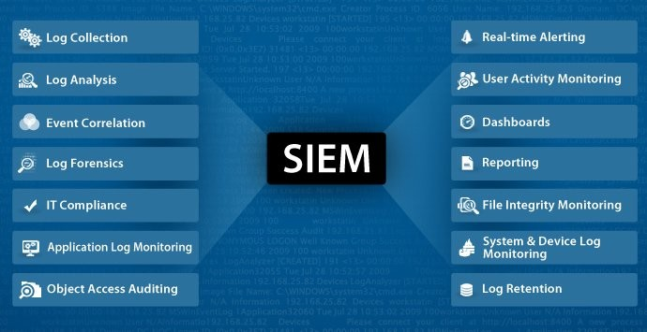
SIEMs and Log Analysis
Notes:
Graphic: https://www.linkedin.com/pulse/security-information-event-management-toolsfor-analyst-saheed-oyedele-ake1e/

Slide 33
Key Tools for SIEMs and Log Analysis
Splunk
Elastic Stack (ELK)
Graylog
ICS-Specific Tools (Dragos, Nozomi Networks)
Tool | Features | Use Case
Splunk | Real-time search and alerting | Detect failed logins on SCADA systems
Elastic Stack (ELK) | Open-source, customizable | Monitor Modbus traffic logs for anomalies
Graylog | Lightweight, easy configuration | Alert on changes in ICS configuration logs
Dragos | OT-specific threat detection | Identify unauthorized commands to PLCs
Notes:
Splunk
Overview:
A powerful platform for collecting, analyzing, and visualizing log data.
Features:
Advanced search and reporting capabilities.
Real-time alerting for suspicious activities.
Support for ICS-specific log sources.
Use Case:
Detect repeated failed login attempts on SCADA systems.
Correlate logs across HMIs, PLCs, and firewalls.
Elastic Stack (ELK)
Overview:
Open-source suite for log management and analysis.
Features:
Elasticsearch for fast search and analysis.
Logstash for ingesting and transforming data.
Kibana for visualizing trends and anomalies.
Use Case:
Monitor Modbus traffic logs for anomalies or unexpected commands.
Graylog
Overview:
User-friendly log management system with custom dashboards.
Features:
Centralized log collection and analysis.
Rule-based alerting.
Lightweight and easily configurable for ICS environments.
Use Case:
Monitor and alert on changes in ICS configuration logs.
ICS-Specific Tools
Dragos:
Focused on OT threat detection and incident response.
Provides ICS protocol awareness and asset monitoring.
Nozomi Networks:
Real-time network visibility and anomaly detection for industrial systems.
Use Case:
Detect unauthorized Modbus commands targeting PLCs.
Graphic Source: Author-generated

Slide 34
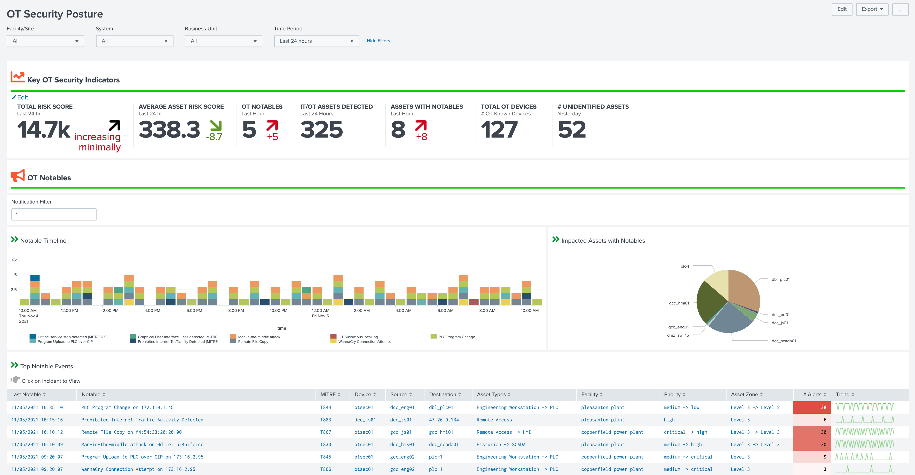
Splunkbase: OT Security Add-on
Notes:
The OT Security Add-on for Splunk is designed to enhance the security of Operational Technology (OT) environments by integrating with Splunk Enterprise Security. This add-on helps bridge the gap between Information Technology (IT) and OT, providing a more holistic view of an organization's security posture and improving incident response times.
Key features of the OT Security Add-on include:
Real-time Visibility: It offers comprehensive monitoring capabilities across OT assets, utilizing tactics, techniques, and procedures from the MITRE ATT&CK for ICS framework to enhance detection and characterization of potential security threats.
Enhanced Compliance: The add-on supports compliance with critical infrastructure protection standards such as NERC CIP, automating reporting and streamlining compliance activities to ensure that energy and utility sectors meet regulatory requirements efficiently.
Security Orchestration, Automation, and Response (SOAR): This feature automates responses and case management within the context of OT, which helps in speeding up the response times and improving the efficiency of security operations.
Advanced Threat Detection and Management: It includes capabilities to better manage and respond to threats by integrating advanced detection rules that align with MITRE ICS TTPs and providing detailed dashboards and reports for deeper insights into security events.
Graphic: https://images.app.goo.gl/qSEmjX1qs7XTyu916

Slide 35
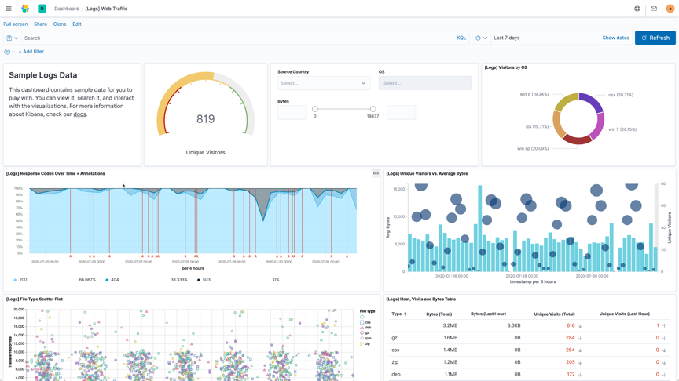
Elastic (ELK) Stack
Notes:
The Elastic (ELK) Stack offers a comprehensive set of features designed to handle various aspects of data management and analysis. Key features of the ELK Stack include:
Elasticsearch: At the core of the stack, it serves as a powerful search and analytics engine. It supports complex queries, efficient storage, fast retrieval, and scalability.
Logstash: This component is used for data ingestion. It collects, processes, and forwards data to Elasticsearch. Logstash is known for its flexibility and integrates with a multitude of data sources while allowing transformation and enrichment of the data before it is indexed.
Kibana: Acts as the visualization layer on top of Elasticsearch. It provides a user-friendly interface to visualize data with charts, graphs, and dashboards. Kibana also enables users to perform advanced data analysis and navigate through large volumes of data.
Beats: Lightweight data shippers that send data from hundreds of or thousands of machines and systems to Logstash or Elasticsearch.
Security Features: Includes features like role-based access control (RBAC), encryption, IP filtering, and integration with various authentication mechanisms (LDAP, Active Directory, SAML, etc.).
Alerting and Notification: Allows setting up alerts based on data patterns. Notifications can be integrated with various platforms like email, Slack, and more for real-time alerting.
Machine Learning: Supports anomaly detection to identify unusual patterns in your data which is crucial for security and operational intelligence.
Management and Operations Tools: Tools for monitoring the health and performance of the Elastic Stack itself, and features to manage data retention, scaling, and more.
API and UI Upgrades: Offers APIs and UIs to help manage and upgrade your Elastic Stack environments, ensuring you are on the latest version with all the new features and security updates.
Graphic: https://images.app.goo.gl/JBBqUjnxBRyk4bwE9

Slide 36
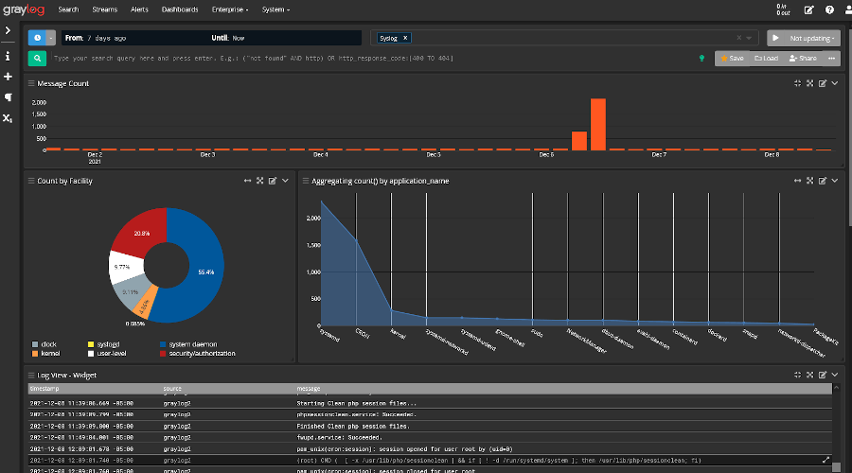
Graylog
Notes:
Graylog is a robust log management and analysis solution that offers a variety of features to enhance data handling and operational efficiency. Here’s an overview of key features provided by Graylog:
Centralized Log Management: Graylog enables efficient log collection and management across various sources, providing a unified view of data.
Real-Time Search and Analysis: It allows for quick search capabilities across large datasets, facilitating faster responses to queries and issues.
Alerts and Notifications: Graylog supports configurable alerts that can notify users of critical incidents or anomalous activities.
Dashboards and Reports: Users can create customizable dashboards and reports to visualize and monitor data metrics and trends effectively.
Data Enrichment: Graylog can augment incoming data with additional context to enhance the information available for analysis.
Scalable Architecture: Designed to handle high volumes of data and scale with the needs of an organization.
Security Operations: Integrates features that support security operations, including threat detection, incident response, and compliance auditing.
Anomaly Detection: Capable of identifying unusual patterns that may indicate security threats or operational issues.
Archiving and Retention: Offers data archiving capabilities to meet compliance and regulatory requirements.
Audit Management: Tracks changes and activities within the system to ensure traceability and security.
Role-Based Access Control (RBAC): Enhances security by ensuring that only authorized users can access certain data based on their roles.
APIs and Integration: Graylog provides APIs and supports numerous integrations to enhance functionality and connectivity with other systems.
Graphic: https://images.app.goo.gl/wfbbumYPqzvrFXNx5

Slide 37
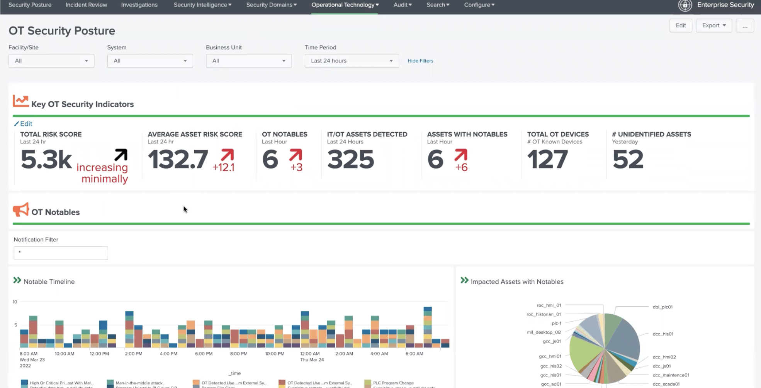
Dragos
Notes:
The Dragos platform offers a robust set of features specifically designed for securing industrial control systems (ICS) and operational technology (OT) environments. Key features of the Dragos platform include:
Advanced Threat Detection: The platform utilizes state-of-the-art technology to swiftly and accurately identify threats, providing enhanced security measures tailored to the unique needs of ICS environments.
Deep Visibility: Dragos offers comprehensive monitoring capabilities that allow for the discovery, management, and surveillance of OT, IT, IoT, and cyber-physical systems across various environments, ensuring thorough asset visibility.
Risk-Based Vulnerability Management: This feature provides prioritized, actionable guidance for the complete lifecycle management of vulnerabilities, tailored specifically with OT context in mind, helping organizations focus on the most critical issues first.
Simplified Investigations: Dragos simplifies complex investigations with forensic data and expert-authored response playbooks, streamlining security operations and reducing response times.
Power of the Dragos Ecosystem: The platform is supported by OT Watch Threat-Hunting-as-a-Service, Community Defense with Dragos Neighborhood Keeper, and actionable Cyber Threat Intelligence (CTI) from Dragos Worldview, enhancing the security operations of industrial environments.
Intelligence-Driven Threat Detection: Dragos goes beyond simple anomaly detection by integrating proprietary threat intelligence into its platform, offering detailed insights into adversary behaviors and tactics.
Neighborhood Keeper: This feature allows for shared intelligence on real-world threats and vulnerabilities, enhancing collective defense capabilities across the industrial community.
OT Watch: Dragos OT Watch provides threat-hunting-as-a-service, adding an extra layer of security by proactively hunting for adversaries within customer environments.
Flexible Deployment Options: The Dragos platform supports virtual, on-premises, or cloud-based deployment, providing flexibility to meet the specific needs of various industrial environments.
Graphic: https://www.linkedin.com/pulse/security-information-event-management-toolsfor-analyst-saheed-oyedele-ake1e/

Slide 38
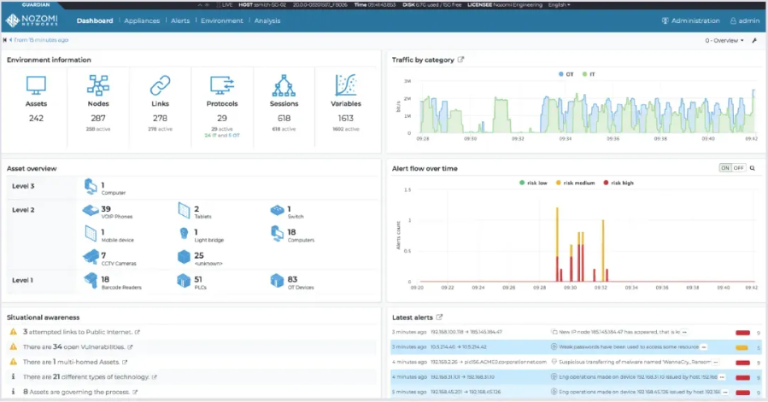
Nozomi Guardian
Notes:
Nozomi Guardian offers a suite of features designed for robust cybersecurity in OT and IoT environments. Key features of the Nozomi Guardian include:
Comprehensive Asset Inventory: Guardian provides detailed visibility and monitoring of OT and IoT assets, helping to maintain an accurate asset inventory which includes extensive node information such as name, type, and firmware version.
Network Visualization: The platform offers tools for real-time network visualization, enabling users to quickly identify network topologies, communications, and potential issues within the infrastructure.
Automated Vulnerability Assessment: Guardian automatically identifies vulnerabilities in devices and facilitates prioritization and remediation through intuitive dashboards and detailed reports.
Advanced Anomaly and Threat Detection: The system uses behavior-based analytics to detect anomalies and potential cybersecurity threats, enhancing the security posture against advanced threats.
Reduced Mean Time to Recovery: By using playbooks that guide remediation efforts, Guardian helps organizations reduce the time to recover from security incidents.
Accelerated Cyber Risk Management: The platform enables fast responses to potential incidents with actionable intelligence and comprehensive visualization tools that aid in both macro and micro-level analysis.
Graphic: https://www.nozominetworks.com/products/guardian

Slide 39
Techniques for Log Analysis: Pattern Matching
Definition: Identify known Indicators of Compromise (IOCs) in log data, such as specific IP addresses, filenames, or registry keys.
Use Case: Detect multiple failed login attempts or repeated access to sensitive directories.
Example Query (Splunk):
index="ics_logs" action="failed_login" | stats count by user, source_ip
Notes:
Pattern Matching
Definition:
Identify known Indicators of Compromise (IOCs) in log data, such as specific IP addresses, filenames, or registry keys.
Use Case:
Detect multiple failed login attempts or repeated access to sensitive directories.
Example Query (Splunk):
index="ics_logs" action="failed_login" | stats count by user, source_ip
Graphic Source:

Slide 40
Techniques for Log Analysis: Anomaly Detection
Definition: Detect deviations from normal behavior in system or network logs.
Use Case: Identify unexpected spikes in traffic to a PLC or unusual command activity in Modbus logs.
Example:
Sudden increase in outbound traffic volume from an engineering workstation.
Notes:
Anomaly Detection
Definition:
Detect deviations from normal behavior in system or network logs.
Use Case:
Identify unexpected spikes in traffic to a PLC or unusual command activity in Modbus logs.
Example:
Sudden increase in outbound traffic volume from an engineering workstation
Graphic Source:

Slide 41
Techniques for Log Analysis: Correlation
Definition: Link events across multiple log sources to create a full picture of an incident.
Use Case: Match login failures in Active Directory logs with firewall traffic to detect brute-force attacks.
Example Workflow: Correlate HMI activity logs with SCADA system alerts to confirm unauthorized actions.
Notes:
Correlation
Definition:
Link events across multiple log sources to create a full picture of an incident.
Use Case:
Match login failures in Active Directory logs with firewall traffic to detect brute-force attacks.
Example Workflow:
Correlate HMI activity logs with SCADA system alerts to confirm unauthorized actions.
Graphic Source:

Slide 42
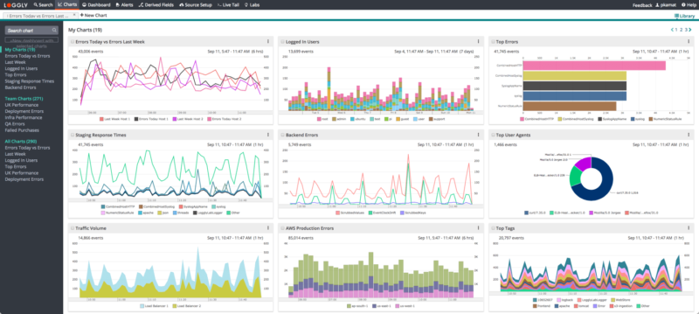
Techniques for Log Analysis: Visualization
Definition: Use dashboards and charts to identify patterns and trends quickly.
Use Case: Monitor login activity, protocol usage, or traffic anomalies visually.
Example: A time-series chart showing failed login attempts over time to highlight an ongoing attack.
Notes:
Visualization
Definition:
Use dashboards and charts to identify patterns and trends quickly.
Use Case:
Monitor login activity, protocol usage, or traffic anomalies visually.
Example:
A time-series chart showing failed login attempts over time to highlight an ongoing attack.
Graphic Source: https://images.app.goo.gl/RAWeo4J6E55rMf8g6

Slide 43
Practical Use Cases in SIEMs and Log Analysis
External Connections and Data Exfiltration
Scenario: Unexpected outbound traffic to unfamiliar IP addresses.
Detection: Use network logs in a SIEM to identify abnormal data flows
Example Query:
index="firewall_logs" dest_ip!="whitelisted_IPs" | stats count by dest_ip
Response: Block suspicious connections at the firewall.
Notes:
External Connections and Data Exfiltration
Scenario:
Unexpected outbound traffic to unfamiliar IP addresses.
Detection:
Use network logs in a SIEM to identify abnormal data flows.
Example Query:
index="firewall_logs" dest_ip!="whitelisted_IPs" | stats count by dest_ip
Response:
Block suspicious connections at the firewall.
Example Tool:
Splunk or ELK Stack for correlation of logs from multiple endpoints.
Graphic Source:

Slide 44
Practical Use Cases in SIEMs and Log Analysis
Active Processes and User Activity
Scenario: An engineering workstation initiates a process that isn’t part of standard operations.
Detection: Analyze system logs for unexpected process launches.
Example Query:
index="syslogs" process!="known_processes" | stats count by host, process
Response: Quarantine the endpoint with EDR tools
Notes:
Active Processes and User Activity
Scenario:
An engineering workstation initiates a process that isn’t part of standard operations.
Detection:
Analyze system logs for unexpected process launches.
Example Query:
index="syslogs" process!="known_processes" | stats count by host, process
Response:
Quarantine the endpoint with EDR tools.
Example Tool:
Sysmon logs analyzed in Graylog or Splunk.
Graphic Source:

Slide 45
Practical Use Cases in SIEMs and Log Analysis
File Manipulations and Registry Changes
Scenario: Anomalies detected in ICS configuration files or unauthorized registry edits.
Detection: Use host-based logs to track file and registry activity.
Example Query:
index="ics_configs" change_type="modified" | table user, timestamp, file
Response: Roll back unauthorized changes.
Notes:
File Manipulations and Registry Changes
Scenario:
Anomalies detected in ICS configuration files or unauthorized registry edits.
Detection:
Use host-based logs to track file and registry activity.
Example Query:
index="ics_configs" change_type="modified" | table user, timestamp, file
Response:
Roll back unauthorized changes using system snapshots.
Example Tool:
OSQuery or Sysinternals.
Graphic Source:

Slide 46
Practical Use Cases in SIEMs and Log Analysis
Command-and-Control (C2) Detection
Scenario: Devices communicating with known malicious IPs or domains.
Detection: Cross-reference SIEM logs with threat intelligence feeds.
Example Query:
index="network_logs" dest_ip IN [threat_intel_list]
Response: Isolate affected devices and investigate further.
Notes:
Command-and-Control (C2) Detection
Scenario:
Devices communicating with known malicious IPs or domains.
Detection:
Cross-reference SIEM logs with threat intelligence feeds.
Example Query:
index="network_logs" dest_ip IN [threat_intel_list]
Response:
Isolate affected devices and investigate further.
Example Tool:
Zeek or Suricata logs integrated with Splunk.
Graphic Source:

Slide 47
Practical Use Cases in SIEMs and Log Analysis
Summary
Use Case | Detection Method | Example Tool
External Connections/Data Exfiltration | Analyze abnormal outbound traffic | Splunk, ELK
Active Processes/User Activity | Identify unexpected processes | Sysmon, Graylog
File Manipulations/Registry Changes | Track unauthorized modifications | OSQuery, Sysinternals
Command-and-Control (C2) Detection | Match network logs with threat feeds | Zeek, Suricata
Notes:
Summary of Use Cases
Graphic Source: Author-created table

Slide 48
Advanced Querying Techniques
Why Advanced Queries are Critical?
Refine search results to focus on high-priority incidents.
Correlate data across multiple log sources to uncover hidden threats.
Automate detection with saved queries and alerts.
Reducing false positives
Supporting forensic investigations
Notes:
Refining Search Results
Challenge: Raw log data is often overwhelming, containing thousands of events.
Solution: Advanced queries allow precision filtering to focus only on high-priority events.
Example: Instead of searching all login events, filter for failed logins from external IPs.
Correlating Data Across Multiple Sources
Challenge: Security events often involve multiple systems (firewalls, endpoints, Active Directory, ICS devices).
Solution: Queries can combine logs from multiple sources to uncover hidden threats.
Example: Matching failed login attempts in Active Directory logs with unusual firewall traffic.
Automating Threat Detection
Challenge: Analysts manually searching through logs is inefficient.
Solution: Advanced queries can be saved and automated for continuous monitoring.
Example: A SIEM rule automatically detects multiple failed login attempts within a short time frame.
Reducing False Positives
Challenge: Basic keyword searches often return too many unrelated results.
Solution: Advanced queries apply conditional logic to reduce noise.
Example: Instead of all failed logins, filter only for:
Users attempting 5+ failed logins in 1 minute.
Failed logins from non-corporate IP ranges.
Supporting Forensic Investigations
Challenge: During an incident, quickly identifying the root cause is critical.
Solution: Advanced queries help track attacker movements and reconstruct events.
Example: Query logs for file access history of a compromised user account.
Graphic Source:

Slide 49

Advanced Querying Techniques
Common Query Languages
SPL (Splunk Processing Language): Tailored for log analysis in Splunk
Example Query:
index="ics_logs" event_type="failed_login" | stats count by user, source_ip
Notes:
Common Query Languages
SPL (Splunk Processing Language):
Tailored for log analysis in Splunk.
Example Query:
index="ics_logs" event_type="failed_login" | stats count by user, source_ip
Graphic Source: https://images.app.goo.gl/u451pEb7aeHEfHcQ8

Slide 50
Advanced Querying Techniques
Sample Splunk Query
index=main sourcetype=access_log | top limit=10 status
index=main: This specifies that Splunk should look in the main index
sourcetype=access_log: Only logs from a source type access_log
| top limit=10 status: Use the top command to calculate the most common values of the status field
Notes:
index=main: This specifies that Splunk should look in the main index. Indexes in Splunk are storage locations for logs.
sourcetype=access_log: This narrows down the search to only logs that come from a source type labeled as access_log, which typically includes web server access logs.
| top limit=10 status: This part of the query uses the top command to calculate the most common values of the status field (HTTP status codes), limiting the display to the top 10 results.
Graphic Source:

Slide 51
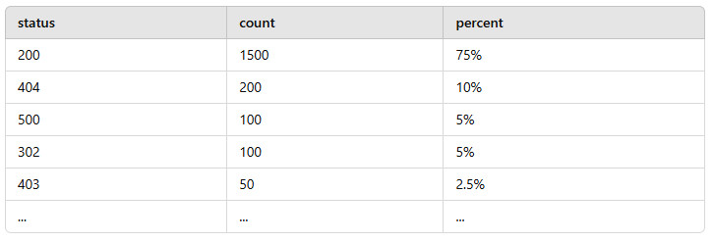
Advanced Querying Techniques
Sample Splunk Results
Notes:
Status: Represents the HTTP status codes that have been logged.
Count: Shows how many times each status code was logged.
Percent: Indicates what percentage of the total logs each status code represents.
Graphic Source: https://images.app.goo.gl/u451pEb7aeHEfHcQ8

Slide 52

Advanced Querying Techniques
Common Query Languages
KQL (Kusto Query Language): Used in Azure Sentinel and Elastic Stack
Example Query:
SecurityEvent | where EventID == 4625 | summarize count() by AccountName
Notes:
Common Query Languages
SPL (Splunk Processing Language):
Tailored for log analysis in Splunk.
Example Query:
index="ics_logs" event_type="failed_login" | stats count by user, source_ip
Graphic Source: https://images.app.goo.gl/42oQsAzKPAqSuX3d8

Slide 53
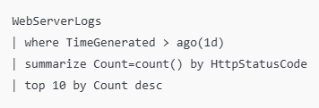
Advanced Querying Techniques
Sample KQL Query
Notes:
WebServerLogs: This is the name of the table where logs are stored. You would replace "WebServerLogs" with the actual name of your log table.
where TimeGenerated > ago(1d): This filters the data to only include logs generated in the last 24 hours.
summarize Count=count() by HttpStatusCode: This command aggregates the logs, counting them by the HTTP status code field.
top 10 by Count desc: This displays the top 10 results ordered by the count in descending order.
Graphic Source: https://images.app.goo.gl/42oQsAzKPAqSuX3d8

Slide 54
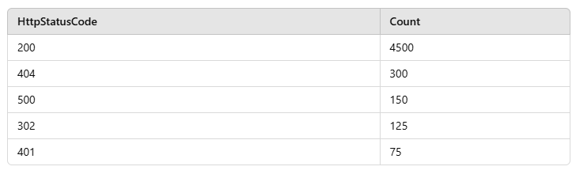
Advanced Querying Techniques
Sample KQL Results
Notes:
Status: Represents the HTTP status codes that have been logged.
Count: Shows how many times each status code was logged.
Percent: Indicates what percentage of the total logs each status code represents.
Graphic Source: Author-generated table

Slide 55

Advanced Querying Techniques
Common Query Languages
SQL-Based Queries: Used in OSQuery or other SQL-based systems for system state analysis.
Example Query:
SELECT process_name, user FROM processes WHERE start_time > '2025-01-01 00:00:00';
Notes:
SQL-Based Queries: Used in OSQuery or other SQL-based systems for system state analysis.
Example Query:
SELECT process_name, user FROM processes WHERE start_time > '2025-01-01 00:00:00';
Graphic Source: https://images.app.goo.gl/rT19s5Kp2KtkogNYA

Slide 56
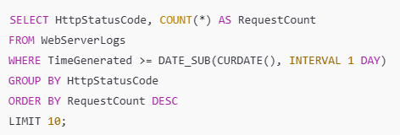
Advanced Querying Techniques
Sample SQL Query
Notes:
SELECT HttpStatusCode, COUNT(*) AS RequestCount: This part of the query selects the HTTP status code and counts the number of occurrences of each status code.
FROM WebServerLogs: Specifies the table that contains the log data.
WHERE TimeGenerated >= DATE_SUB(CURDATE(), INTERVAL 1 DAY): This condition filters the logs to include only those generated in the last 24 hours.
GROUP BY HttpStatusCode: Groups the results by HTTP status code, which is necessary for the count calculation.
ORDER BY RequestCount DESC: Orders the results by the count of requests in descending order, showing the most frequent statuses first.
LIMIT 10: Limits the output to the top 10 results.
Graphic Source: https://images.app.goo.gl/rT19s5Kp2KtkogNYA

Slide 57
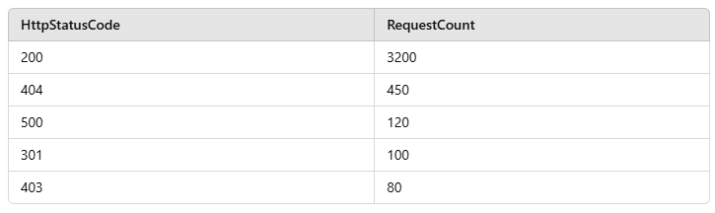
Advanced Querying Techniques
Sample SQL Results
Notes:
The result would be a table listing the top 10 HTTP status codes by occurrence within the last day
This query would help in analyzing the types of HTTP responses your web server is most frequently returning, which can be crucial for monitoring the health of web services and identifying issues like frequent 404s or 500s which might indicate problems.
Graphic Source: https://images.app.goo.gl/rT19s5Kp2KtkogNYA

Slide 58
Advanced Querying Techniques
Filters and Conditions
Aggregations
Join Operations
Creating Alerts and Automations
Sample Alert Rule (Splunk):
index="ics_logs" action="failed_login" | stats count by user | where count > 10
Notes:
Filters and Conditions:
Narrow down results by applying specific filters.
Example: Show only failed logins from external IPs.
Aggregations:
Summarize data for trends or patterns.
Example: Count failed logins by user or device.
Join Operations:
Correlate data across different logs.
Example: Match user activity logs with firewall logs to identify suspicious behavior.
Creating Alerts and Automations
Save advanced queries to create real-time alerts.
Example: Trigger an alert for more than 10 failed login attempts in 5 minutes.
Sample Alert Rule (Splunk):
index="ics_logs" action="failed_login" | stats count by user | where count > 10
Graphic Source:

Slide 59
Use Cases for Advanced Queries
Detecting Suspicious Activity
Example: Identify unusual registry changes
Tracking Lateral Movement
Example: Query logs to find unusual traffic patterns
Correlating Events
Example: Link unauthorized file modifications with network activity logs
Notes:
Use Cases for Advanced Queries
Detecting Suspicious Activity:
Example: Identify unusual registry changes using OSQuery.
Tracking Lateral Movement:
Example: Query logs to find unusual traffic patterns between devices.
Correlating Events:
Example: Link unauthorized file modifications with network activity logs.
Graphic Source:

Slide 60
Universal Forwarders in ICS Environments
What Are Universal Forwarders?
Lightweight agents installed on systems to collect logs.
Forward logs to a centralized server or SIEM for analysis.
Support real-time or batch log transmission.
Examples: Splunk, Logstash, NXLog, Fluentd
Notes:
Definition
Universal forwarders are lightweight agents that collect and send logs from endpoints to a centralized system for analysis.
They ensure real-time or scheduled log transmission without consuming significant system resources.
Purpose in ICS Environments
Enables centralized logging and monitoring for industrial control systems (SCADA, PLCs, HMIs).
Helps detect security incidents by forwarding logs to SIEM platforms like Splunk, ELK, or Graylog.
How They Work
Installed on endpoints, servers, or ICS devices.
Collects various log types (Windows Event Logs, syslogs, application logs).
Forwards logs to a central log collector or SIEM for further analysis.
Examples of Universal Forwarders
Splunk Universal Forwarder – Optimized for forwarding logs to Splunk indexers.
Logstash Forwarder – Used in Elastic Stack (ELK) to aggregate and transport logs.
NXLog – A lightweight and flexible log collection agent for Windows and Linux.
Fluentd – Open-source forwarder for log aggregation and structured data collection.
Graphic Source: none

Slide 61
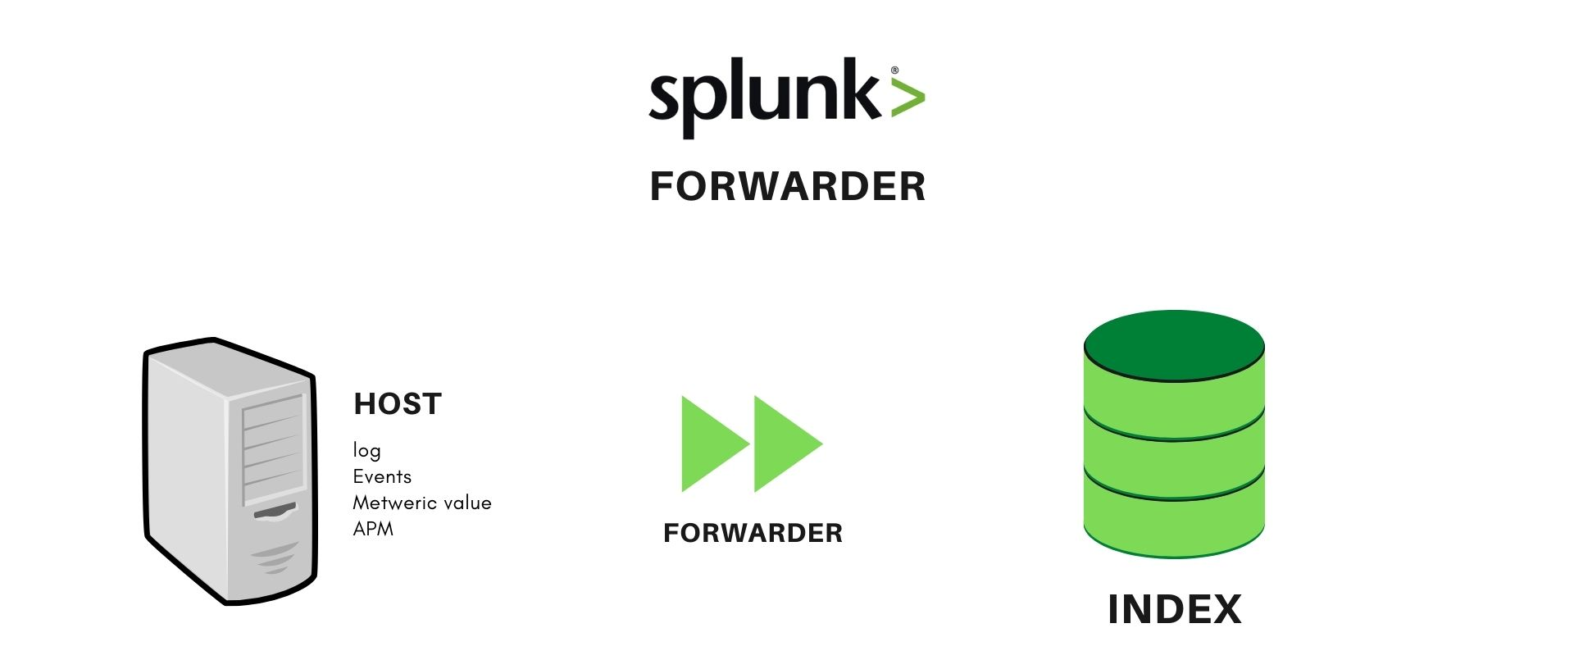
Key Features of Universal Forwarders
Lightweight and Efficient
Versatile Log Collection
Real-Time Forwarding
Secure Transmission
Filtering and Transformation
Notes:
Lightweight and Efficient
Minimal resource usage, making them ideal for ICS environments.
Runs in the background with a low system footprint.
Example: A Splunk Universal Forwarder on an HMI device does not interfere with critical ICS operations.
Versatile Log Collection
Supports various log types, including:
Windows Event Logs (e.g., authentication logs, system logs).
Syslogs (Linux-based system logs).
Application Logs (SCADA, HMI, PLC logs).
Example: NXLog collects logs from both Windows and Linux ICS devices.
Real-Time and Scheduled Forwarding
Can send logs immediately or in batches to optimize bandwidth.
Helps ensure timely detection of security threats.
Example: Forwarding logs in real-time to detect unauthorized remote access attempts.
Secure Transmission
Uses encryption (TLS/SSL) to ensure logs are securely sent to a SIEM.
Supports authentication to prevent unauthorized log forwarding.
Example: Logstash Forwarder encrypts logs before sending them to an Elastic Stack (ELK) instance.
Filtering and Transformation Capabilities
Can filter unnecessary log data to reduce noise.
Parses and formats logs before forwarding for better indexing.
Example: Fluentd structures JSON logs before sending them to a SIEM.
Graphic Source: https://www.socinvestigation.com/splunk-architecture-forwarder-indexer-and-search-head/

Slide 62
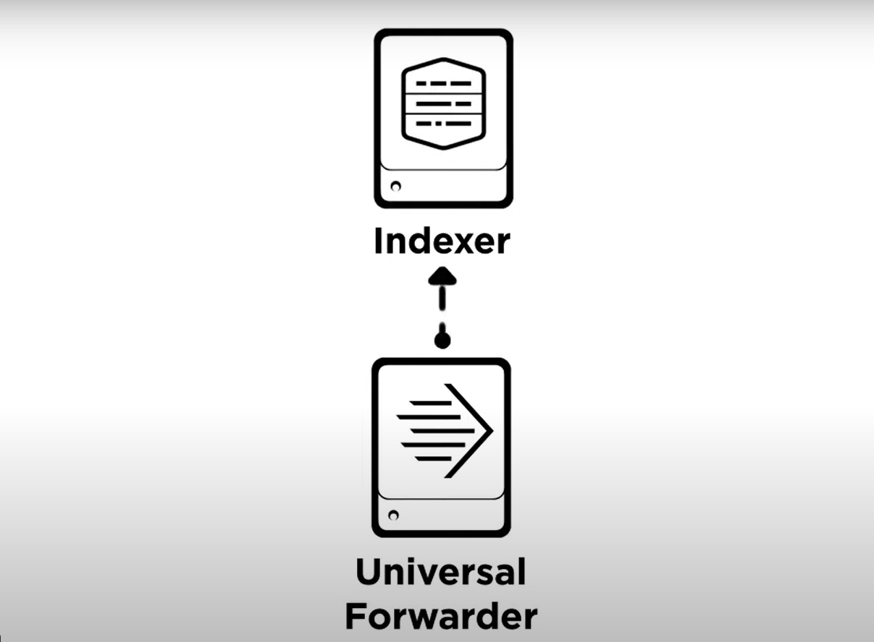
How Universal Forwarders Work
Installation
Log Collection
Log Filtering and Parsing
Secure Transmission
Centralized Analysis
Notes:
Step 1: Installation
Process: Deploy lightweight forwarders on endpoints, servers, or ICS devices (e.g., HMIs, PLCs).
Details: Installation is simple and requires minimal configuration.
Example: Installing a Splunk Universal Forwarder on a Windows server to collect Event Logs.
Step 2: Log Collection
Process:
Forwarders collect logs from configured sources, such as:
Windows Event Logs
Syslogs (Linux/Unix)
Application-specific logs (SCADA, firewalls, etc.)
Example: Collecting authentication logs from an Active Directory server.
Step 3: Log Filtering and Parsing
Process:
Forwarders can filter out irrelevant data to reduce noise.
Optionally transform or format logs for easier analysis.
Example: Removing verbose system messages or reformatting logs into JSON before forwarding.
Step 4: Secure Transmission
Process: Logs are encrypted (TLS/SSL) and authenticated before being sent to the central server or SIEM.
Example: Forwarding logs to an Elastic Stack (ELK) instance over a secure connection.
Step 5: Centralized Analysis
Process: Logs arrive at the SIEM or central log server for indexing, correlation, and analysis.
Example: Logs analyzed in Splunk to detect unusual login patterns or suspicious processes.
Graphic Source:

Slide 63
Universal Forwarders: Use Cases
Real-Time Monitoring: Collect logs from SCADA systems, HMIs, and PLCs for real-time analysis.
Anomaly Detection: Monitor event logs for unusual activity, such as unauthorized access or configuration changes.
Compliance and Auditing: Ensure log retention for regulatory compliance.
Incident Response: Provide detailed log data to investigate and respond to security incidents.
Notes:
Real-Time Monitoring
Use Case: Collect logs from SCADA systems, HMIs, and PLCs to monitor critical activities.
Example: Detect unusual configuration changes on PLCs by analyzing logs sent in real time.
Benefit: Immediate alerts for anomalies ensure quicker incident response.
Anomaly Detection
Use Case: Identify deviations from baseline behavior, such as unexpected traffic or user activity.
Example: A forwarder detects and forwards logs showing a spike in outbound connections from an HMI.
Benefit: Early detection of potential malware or unauthorized access.
Compliance and Auditing
Use Case: Centralize logs for audit trails to meet regulatory requirements (e.g., NERC CIP, ISO 27001).
Example: Use a universal forwarder to collect and securely store firewall and system access logs for periodic compliance reviews.
Benefit: Simplifies audits and reduces compliance-related penalties.
Incident Response and Forensics
Use Case: Provide detailed logs for post-incident investigation and root cause analysis.
Example: Logs from a forwarder reveal the source IP and user account used in an unauthorized login attempt.
Benefit: Facilitates evidence collection and analysis for remediation.
Graphic Source:

Slide 64
Universal Forwarders: Best Practices
Strategic Placement: Deploy on critical devices, such as SCADA systems, HMIs, and firewalls.
Minimize Bandwidth Impact: Use batch forwarding during low-traffic periods if necessary.
Secure Configurations: Encrypt log transmission and authenticate forwarders with the central server.
Regular Maintenance: Ensure forwarders are up-to-date and operational.
Notes:
Strategic Placement of Forwarders
Deploy forwarders on critical ICS devices:
SCADA systems
HMIs
PLC engineering workstations
Firewalls and ICS gateways
Example: Installing a forwarder on an HMI to capture all user authentication attempts.
Minimize Bandwidth Impact
Use batch forwarding or compression for large log volumes.
Configure logs to send during off-peak hours if real-time forwarding isn’t required.
Example: Engineering logs can be forwarded every 30 minutes instead of instantly.
Secure Configurations
Enable TLS/SSL encryption to prevent log tampering.
Use authentication mechanisms to prevent unauthorized forwarding.
Example: Forwarders sending logs to Splunk should require token-based authentication.
Regular Maintenance and Monitoring
Check for forwarder failures or disconnected sources.
Ensure logs are being received at the SIEM.
Update forwarders regularly to patch vulnerabilities.
Example: Set up an alert in Splunk to detect missing logs from critical ICS devices.
Graphic Source:

Slide 65
Universal Forwarders: Challenges
Challenge: Bandwidth Constraints
Mitigation: Compress logs or forward during off-peak hours.
Challenge: Device Compatibility
Mitigation: Use flexible forwarders that support multiple log formats.
Challenge: Security Concerns
Mitigation: Encrypt log data and authenticate forwarders
Notes:
Challenge: Bandwidth Constraints
Issue: ICS networks are often bandwidth-limited, and excessive log forwarding can cause congestion.
Mitigation:
Use batch forwarding during non-peak hours.
Enable log compression to reduce data size.
Example: A refinery configures forwarders to send logs every 15 minutes instead of real-time.
Challenge: Device Compatibility
Issue: Some ICS devices (e.g., older PLCs) do not support standard log formats or universal forwarders.
Mitigation:
Use protocol converters or ICS-specific log collectors (e.g., Nozomi, Dragos).
Forward logs from network monitoring tools instead of directly from legacy devices.
Example: A legacy PLC without a universal forwarder sends logs via a firewall’s logging capability.
Challenge: Security Concerns
Issue: Logs contain sensitive data, and improper configuration could expose information to attackers.
Mitigation:
Use TLS/SSL encryption for log transmission.
Implement role-based access controls (RBAC) to restrict log access.
Example: A power plant ensures that only security analysts can access log data from their SIEM
Graphic Source:

Slide 66

Identifying Malicious Processes and Users
Notes:
Graphic: https://images.app.goo.gl/6L3vhVfzGDHwKzdv6

Slide 67
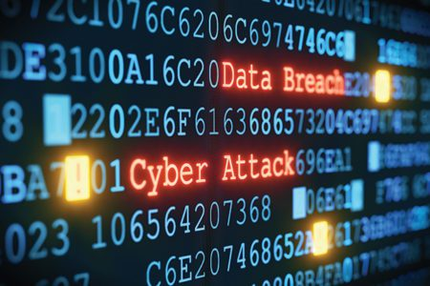
Recognizing Malicious Processes
Unusual Process Behavior
Execution from Suspicious Locations
Unfamiliar or Obfuscated Names
Persistence Mechanisms
Notes:
Unusual Process Behavior
Processes consuming excessive CPU, memory, or disk usage.
Unexpected network activity or outbound connections to unfamiliar IPs.
Example: A process repeatedly attempting to contact a known Command-and-Control (C2) server.
Execution from Suspicious Locations
Processes running from uncommon directories, such as:
%TEMP%, %AppData%, or %SystemRoot%\debug.
Example:
A binary named service.exe found in the %TEMP% directory instead of C:\Windows\System32.
Unfamiliar or Obfuscated Names
Processes with names designed to mimic legitimate system processes.
Examples:
svch0st.exe (malicious) vs. svchost.exe (legitimate).
Randomly generated names like a2f3c.exe.
Persistence Mechanisms
Processes modifying:
Startup configurations (e.g., msconfig, Task Scheduler).
Registry keys (HKLM\Software\Microsoft\Windows\CurrentVersion\Run).
Example: A process adding itself to the startup folder to ensure it runs after every reboot.
Graphic Source: https://images.app.goo.gl/qw3dS1TK6WQZHpzA8

Slide 68

Indicators of Malicious Users
Unauthorized Access Attempts
Privileged Account Abuse
Unusual Activity
Indicators of Insider Threats
Notes:
Unauthorized Access Attempts
Behavior:
Repeated failed login attempts (potential brute force).
Logins during unusual hours or from unexpected locations.
Example: A user account attempting 100 login attempts from a foreign IP address.
Privileged Account Abuse
Behavior:
Administrative accounts accessing sensitive systems or files unrelated to their responsibilities.
Elevation of privileges without authorization.
Example: A finance department user accessing SCADA system configurations.
Unusual Activity
Behavior:
Sudden spikes in file access, downloads, or modifications.
Bulk deletion or creation of files.
Example: A user downloads ICS configuration files in bulk, flagged as abnormal by baseline activity monitoring.
Indicators of Insider Threats
Behavior:
Accessing sensitive information without a business need.
Attempts to disable security tools or tamper with logs.
Example: A disgruntled employee attempts to delete system logs after accessing restricted files.
Graphic Source: https://images.app.goo.gl/KokQeceDfdqvBjyq7

Slide 69
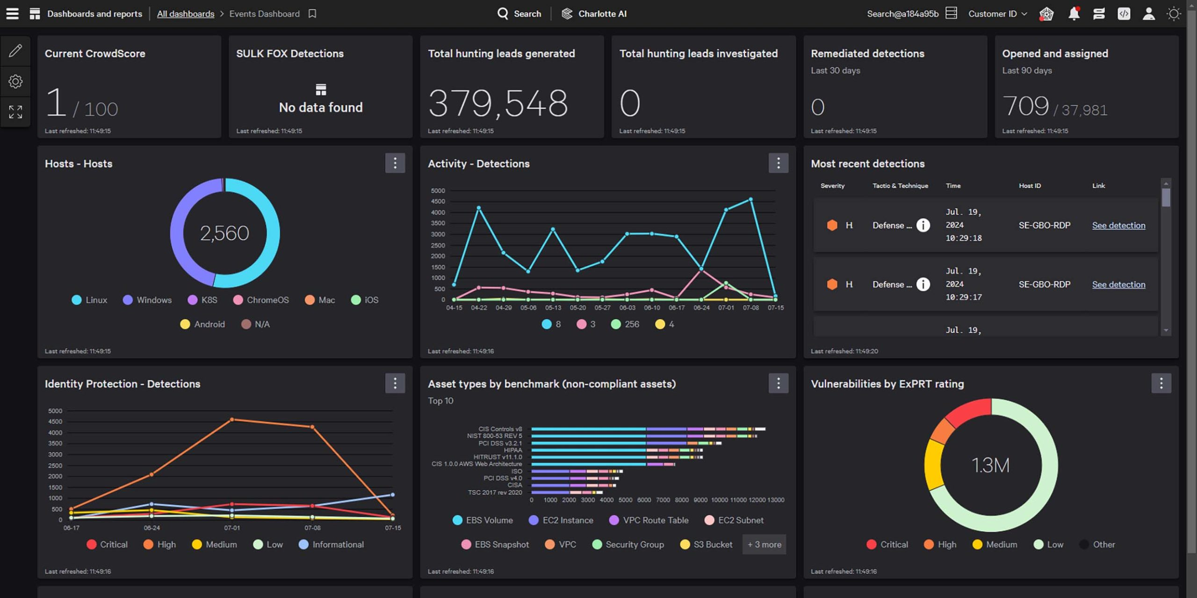
Key Tools for Process Monitoring
Sysinternals Suite
Process Explorer
Autoruns
OSQuery: Query system processes and configuration changes
EDR Tools
CrowdStrike
Carbon Black
Notes:
Sysinternals Suite (Windows-Focused)
Process Explorer:
Displays running processes with detailed information on their parent-child relationships.
Helps detect suspicious processes running under legitimate system services.
Example: Identifying a malicious svch0st.exe process mimicking svchost.exe.
Autoruns:
Lists all programs that start automatically with Windows.
Detects persistence mechanisms used by malware.
Example: Finding a registry key (HKLM\Software\Microsoft\Windows\CurrentVersion\Run) launching a hidden keylogger.
OSQuery
Overview:
Uses SQL-like queries to retrieve system process data.
Ideal for querying multiple endpoints simultaneously.
Use Case: Identifying suspicious processes executing from non-standard directories.
Endpoint Detection and Response (EDR) Tools
Examples: CrowdStrike, Carbon Black, Microsoft Defender for Endpoint.
Capabilities:
Detect and isolate processes showing abnormal behavior.
Record process execution chains for forensic analysis.
Example: Flagging and quarantining a PowerShell script spawning multiple child processes, indicative of fileless malware.
Behavior-Based Detection Tools
Examples: Splunk, Elastic Security, Graylog.
Capabilities: Correlates logs from different sources to identify anomalies.
Example Use Case: Detecting a process making unauthorized outbound network connections.
Graphic Source: https://images.app.goo.gl/VJ6kkz4JVDPvRUzU7

Slide 70

Key Tools for Monitoring User Activity
Active Directory Logs: Track user logins, failed access attempts, and privilege changes
SIEM Platforms: Splunk, ELK Stack for correlating user activity logs
Behavior Analytics Tools
Identify deviations from normal user behavior
Examples: Exabeam, Microsoft Sentinel
Notes:
Active Directory Logs
Purpose: Tracks user authentication events, account changes, and privilege escalations.
Key Logs to Monitor:
Event ID 4625 – Failed login attempts.
Event ID 4672 – Privileged account logins.
Event ID 4720 – New user accounts created.
Example Use Case: Detecting repeated failed login attempts from a privileged account.
SIEM Platforms
Examples: Splunk, ELK Stack (Elasticsearch, Logstash, Kibana), Graylog.
Capabilities:
Correlate user authentication logs across multiple systems.
Detect suspicious behavior based on historical trends.
User Behavior Analytics (UBA)
Examples: Microsoft Sentinel, Exabeam, Varonis.
Capabilities: Uses machine learning to detect deviations from normal user behavior.
Use Case: Detecting a sudden increase in file access requests by a non-admin user.
Graphic Source: https://images.app.goo.gl/GPKETKvvacvk6b4f8

Slide 71
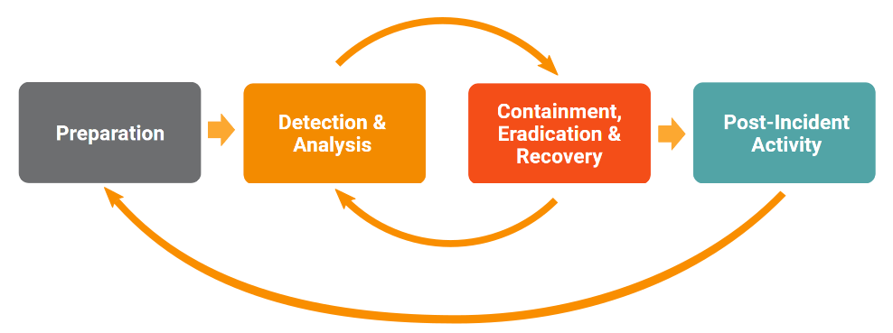
Responding to Malicious Processes
Identify Suspicious Processes
Verify Process Origin
Analyze Related Network Activity
Check for Persistence Mechanisms
Take Containment Actions
Notes:
Identify Suspicious Processes
Use process monitoring tools (e.g., Process Explorer, OSQuery) to detect:
Processes with abnormal resource usage.
Execution from non-standard directories (e.g., %TEMP%, %AppData%).
Example: A process named svch0st.exe running from %AppData%.
Verify Process Origin
Check the legitimacy of the executable by:
Reviewing its digital signature.
Comparing hash values with known-good hashes.
Example: An unsigned executable communicating with an external IP is flagged.
Analyze Related Network Activity
Cross-check process activity with network logs using tools like Wireshark or Zeek.
Example: A process initiating multiple outbound connections to a Command-and-Control (C2) server.
Check for Persistence Mechanisms
Look for indicators of persistence:
Startup entries in msconfig or registry keys (HKLM\Software\Microsoft\Windows\CurrentVersion\Run).
Example: A process creating a scheduled task for automatic execution after reboots.
Take Containment Actions
Steps:
Terminate the suspicious process using tools like Process Explorer.
Quarantine the affected endpoint to prevent lateral movement.
Example: Isolating an infected engineering workstation from the network.
Graphic Source:https://images.app.goo.gl/FMNdhyMR8BHxQoFs5

Slide 72
Module 08 – ICS Hardware Security
Lab and CISA Certs
Lab 8.2 – ICS SIEM
Link Provided By Instructor
CISA ICS Cert 210W-08
https://www.cisa.gov/resources-tools/programs/ics-training-available-through-cisa
Course Title
CRN
©2021 CyberSkills2Work - Institution Name
Notes:
Instructor Notes:
Please complete Lab 6 before next week’s Module. A link to The Risk Assessment report and instructions will be provided to students.

